Slide 1
Combating Multi-camera Interference using Carrier Sensing
DIVYANSHU SAXENA
ABISHEK KUMAR
https://github.com/MCI/Combating MCI using Carrier Sensing

Slide 2
Background: 3D Cameras
3D imaging is being used by vision and robotic systems to recover 3D scene geometry - important for technologies such as autonomous transportation, augmented reality, and robot navigation.
Active 3D Cameras - use a programmable light source to emit coded light, which is used for scene depth estimation.
Specifically, cameras that use the Time-of-flight (ToF) principle are proving useful for this purpose.
As these cameras become more ubiquitous, they face the problem of interference.

Slide 3
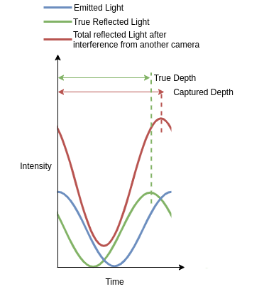
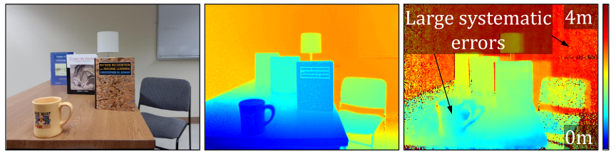
Problem Statement: Multi-camera Interference (MCI) in ToF Cameras
The presence of interfering cameras, we face the issue of depth errors - due to phase shifts
https://wisionlab.cs.wisc.edu/project/stochastictdma/

Slide 4
Motivation: Utilize Wireless Protocols
Interference is a widely studied problem in wireless systems.
In RF Systems, the transmitter sends the data which is carried by the channel to the receiver.
In the MCI scenario, the transmitter sends a light beam, which picks up data from the object and reflects back to the receiver.
Interference happens at the receiver in both cases!

Slide 5
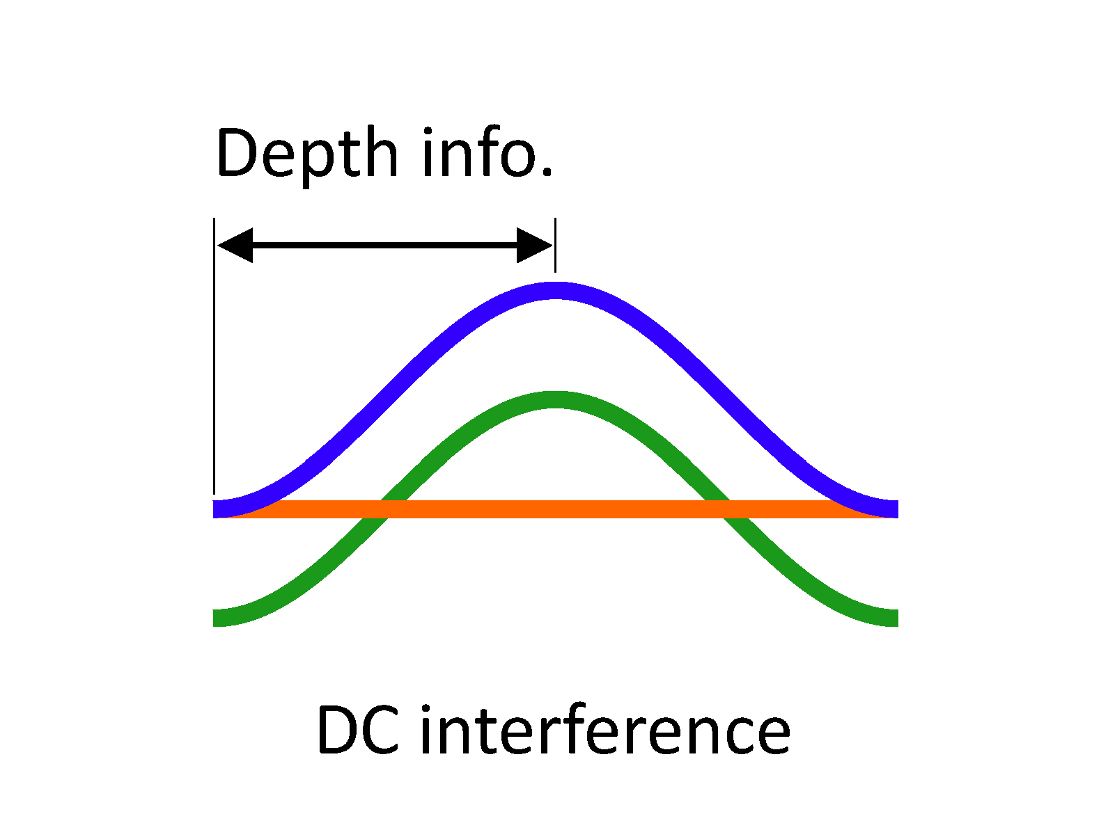
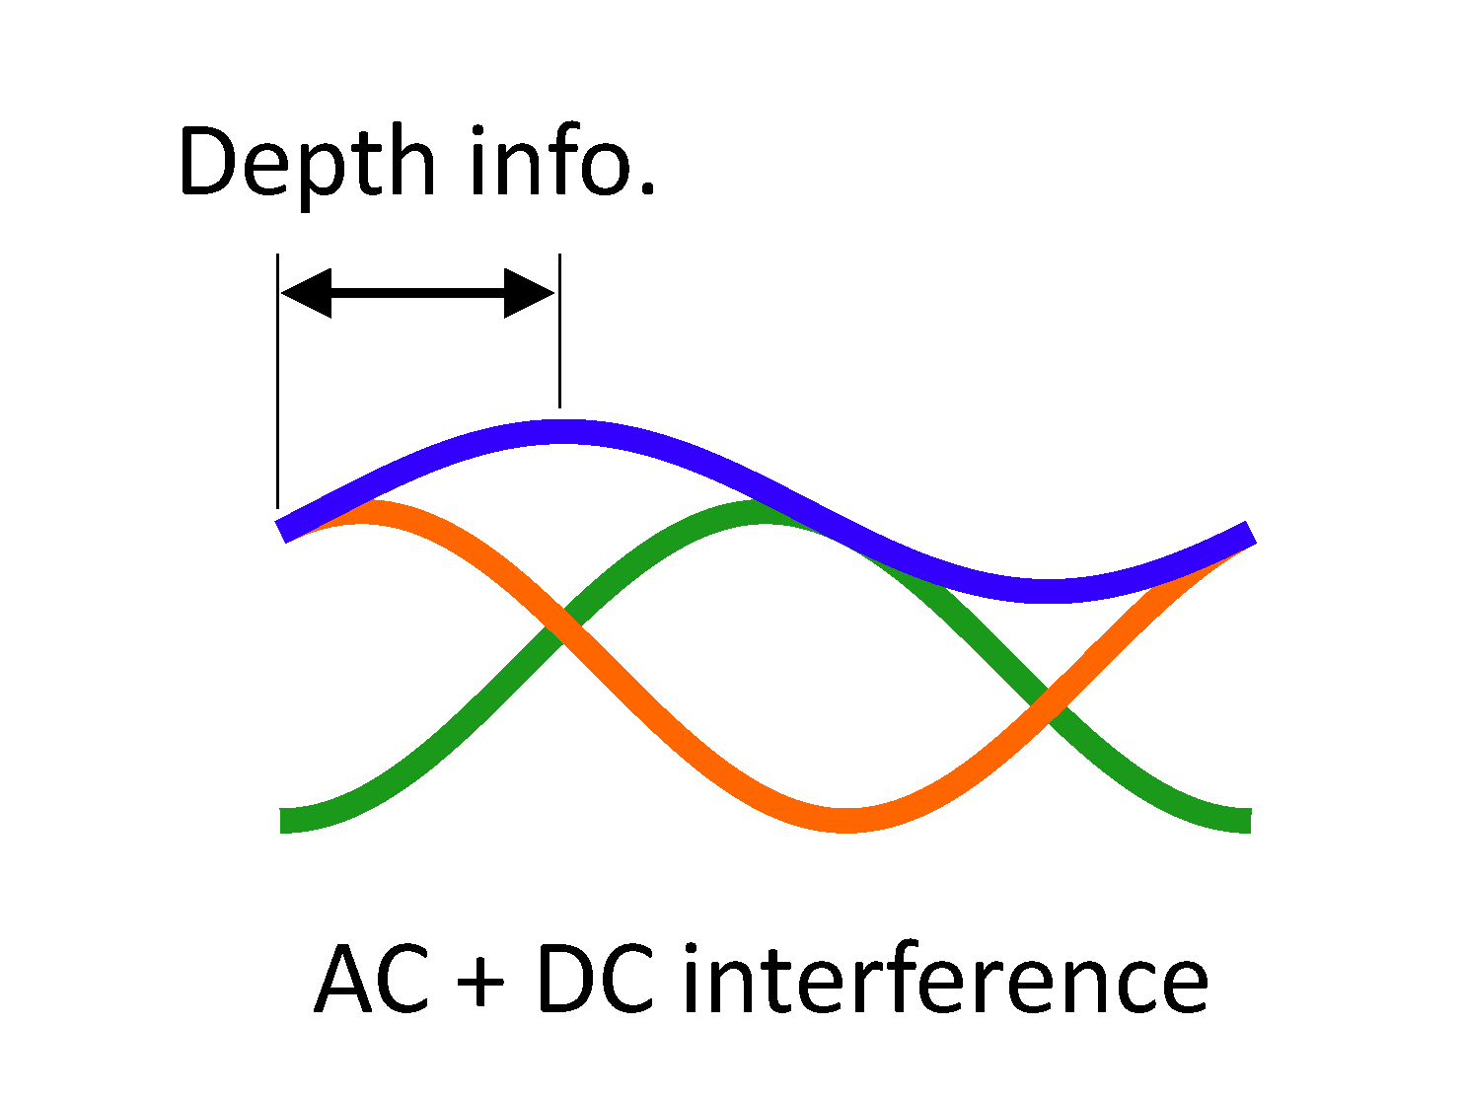
Prior Work: Different Modulation Frequencies
Most conventional systems using ToF Cameras propose using different modulation frequencies for each camera.
However, while this does reduce the interference in the oscillating part - it fails to eliminate the interference in the constant part of the emitted light.
Leads to lower SNR and hence, does not solve the problem completely!

Slide 6
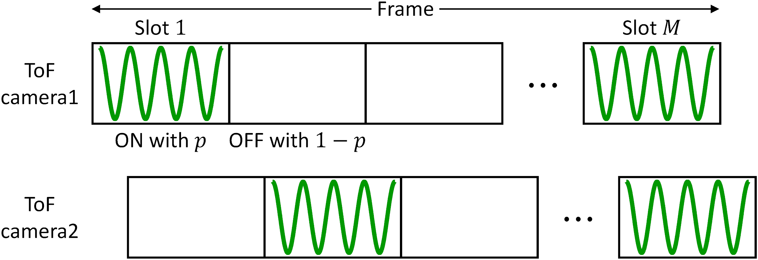
Prior Work: Stochastic Exposure Coding
Similar to the Wireless Protocol Slotted Aloha.
Instead of keeping the emitter and sensor ‘on’ at all times, do a probabilistic switch on-off procedure to reduce the chances of collisions.
https://wisionlab.cs.wisc.edu/project/stochastictdma/

Slide 7
Prior Work: Stochastic Exposure Coding
Similar to the Wireless Protocol Slotted Aloha.
Instead of keeping the emitter and sensor ‘on’ at all times, do a probabilistic switch on-off procedure to reduce the chances of collisions.
There ain’t no free lunch!!!
Increase in the Total Integration Time
Decrease in the Effective Exposure Time
The points above lead to the following constraints:
Increase in Source Power Amplification - to counter the decrease in effective exposure time.
Choice of the Slot ON probability

Slide 8
Prior Work: Stochastic Exposure Coding
Similar to the Wireless Protocol Slotted Aloha.
Instead of keeping the emitter and sensor ‘on’ at all times, do a probabilistic switch on-off procedure to reduce the chances of collisions.
Handling Collisions: Post receive mechanism - if the received light intensity in a slot is higher than the “usual”, declare it a clashed slot.

Slide 9
Intervention: Use Carrier Sensing
Observation:
The current approach of stochastic slots and then do collision detection, is a passive approach. A more active approach can be used.
Drawing inspiration from wireless CSMA-CA protocol, we avoid collisions instead of detecting them.
Additional Benefit: We may not suffer from the Hidden Terminal/Exposed Terminal problems in the MCI scenario.
Occurs widely in wireless systems because transmitter is unaware of the channel state at receiver.
In MCI, transmitter-receiver are co-located!
Result: We still use multiple slots in the total integration time, but the camera only emits light post sensing the channel.

Slide 10
Intervention: Algorithm
1 At each slot
2 Sense the channel to see if it is busy
3 If channel is busy
4 Defer the current slot
5 Else
6 Transmit light and receive from the object post reflection
7 Employ collision detection to check if no camera interfered
8 Use the non clashed slots for depth estimation

Slide 11
Results: Simulation
We evaluate the carrier sensing protocol in an MCI environment, where other cameras may randomly switch on-off with some probability in the entire duration.
Comparison Baselines:
PN (Pseudonoise): Uses non-sinusoid modulation and demodulation functions. Proposed for early ToF cameras in 2007.
ACO (AC Orthogonal): Using orthogonal frequencies for the interfering cameras.
SEC (Stochastic Exposure Coding): Makes use of a stochastic TDMA protocol
CMB: Combined ACO and SEC
CSMA: Intervention to use a-priori carrier sensing

Slide 12
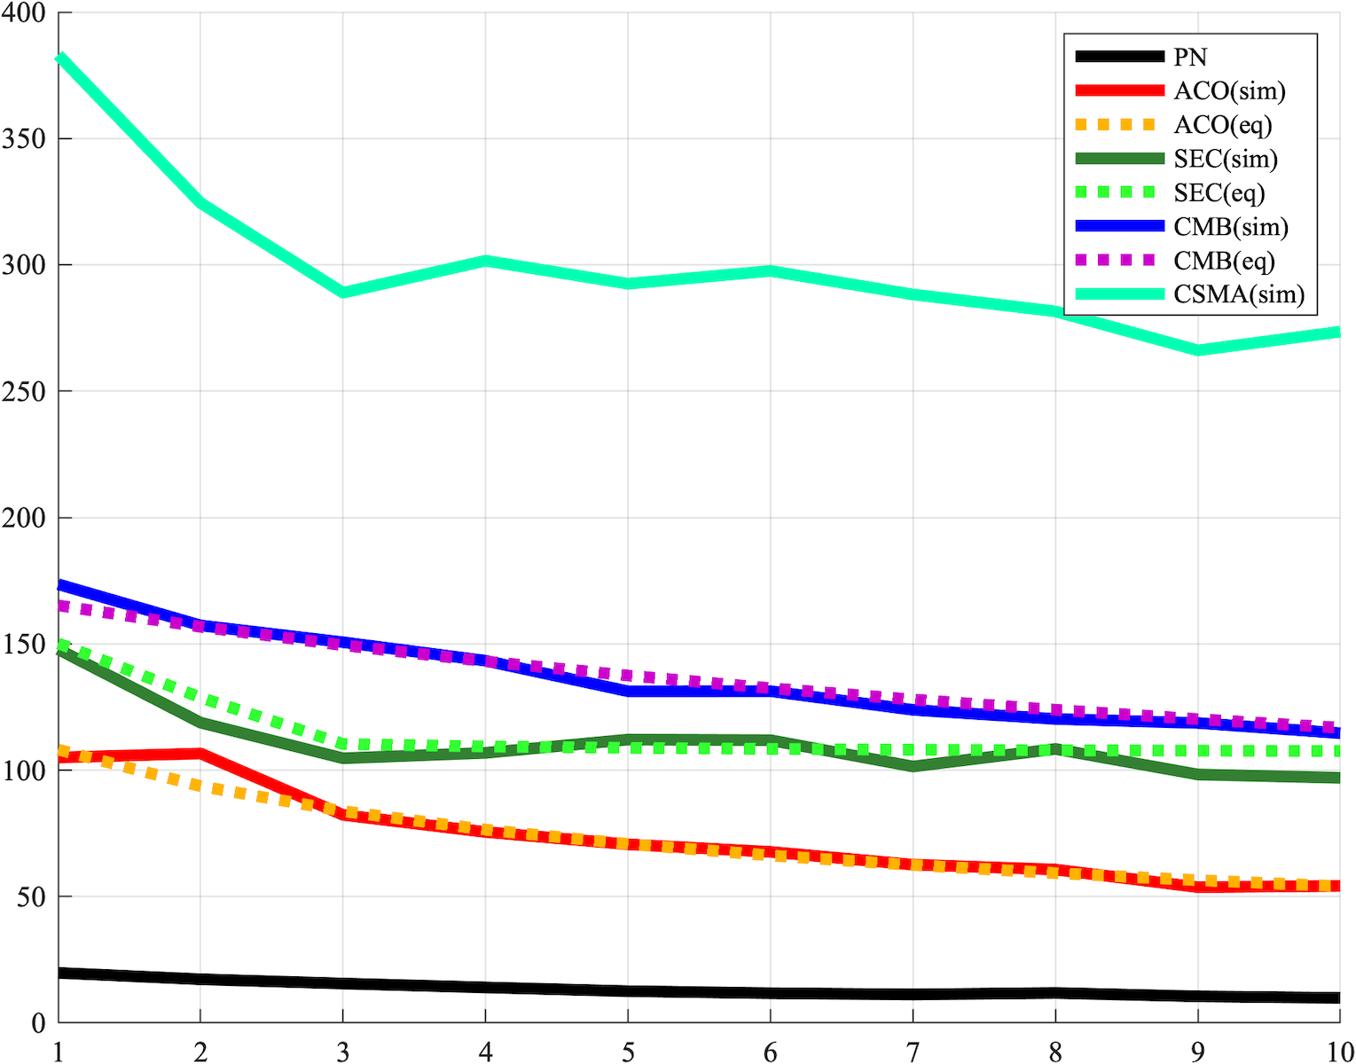
Results: Simulation
Comparison Baselines:
PN (Pseudonoise): Uses non-sinusoid modulation and demodulation functions.
ACO (AC Orthogonal): Using orthogonal frequencies for the interfering cameras.
SEC (Stochastic Exposure Coding): Makes use of a stochastic TDMA protocol
CMB: Combined ACO and SEC
CSMA: Intervention to use a-priori carrier sensing
Following results are for CSMA approach using the same Power Amplification as SEC
Inverse Standard Deviation
Interfering Cameras

Slide 13
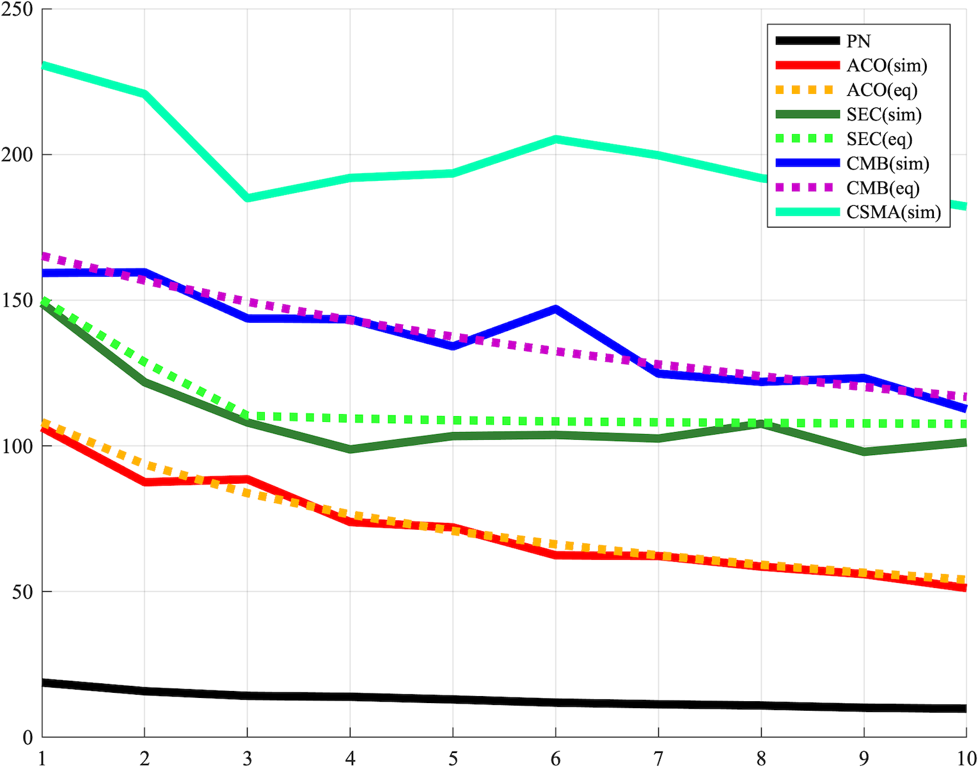
Results: Simulation
Comparison Baselines:
PN (Pseudonoise): Uses non-sinusoid modulation and demodulation functions.
ACO (AC Orthogonal): Using orthogonal frequencies for the interfering cameras.
SEC (Stochastic Exposure Coding): Makes use of a stochastic TDMA protocol
CMB: Combined ACO and SEC
CSMA: Intervention to use a-priori carrier sensing
Following results are for CSMA approach using the half Power Amplification as SEC
Inverse Standard Deviation
Interfering Cameras

Slide 14
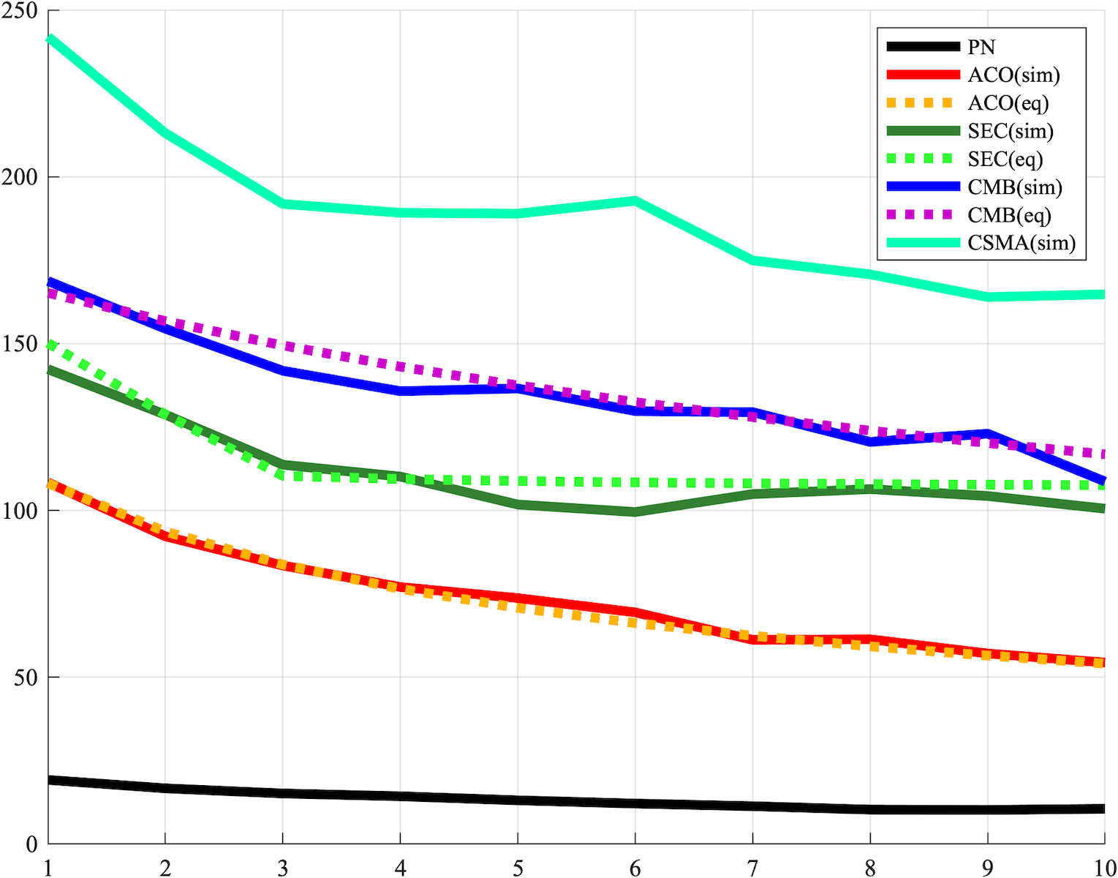
Results: Simulation
Comparison Baselines:
PN (Pseudonoise): Uses non-sinusoid modulation and demodulation functions.
ACO (AC Orthogonal): Using orthogonal frequencies for the interfering cameras.
SEC (Stochastic Exposure Coding): Makes use of a stochastic TDMA protocol
CMB: Combined ACO and SEC
CSMA: Intervention to use a-priori carrier sensing
Following results are for CSMA approach using the half Power Amplification as SEC and 10% increase in probability p_CMB
Inverse Standard Deviation
Interfering Cameras

Slide 15
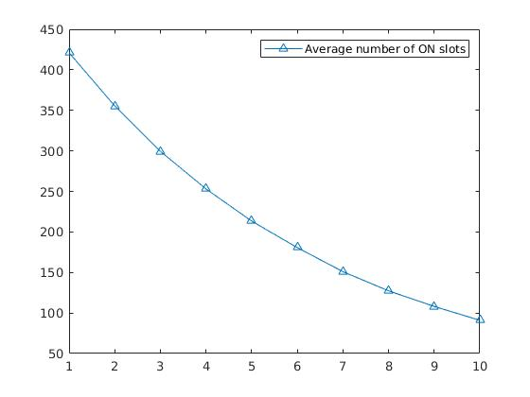
Results: Simulation
The average number of ON slots for the camera following the CSMA protocol, in an MCI environment of interfering cameras switching on and off in each slot with a probability:
Total slots in the integration time = 500

Slide 16
Simulating Real Time Scenarios
The previous algorithm does carrier sensing and depth estimation in the same slot.
In reality, if we employ carrier sensing in every slot, the duration for depth estimation decreases.
To account for this change, we introduce a new parameter – ‘frac’, which determines the fraction of each slot spent in collision detection.

Slide 17
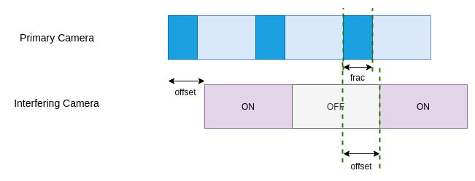
Relationship between Frac and Interference – Case 1
1 If offset > 0 (left case):
2 slot[N] = ! intSlot[N-1]
3 if offset < frac:
4 slot[N] = ! intSlot[N]
5 else:
6 intAmt[N] = (1 - offset)
slot[.] is an array with values 0/1 depicting whether nth slot of primary camera is ON or OFF.
intAmt[.] holds the total observed interference for nth slot for the primary camera.

Slide 18
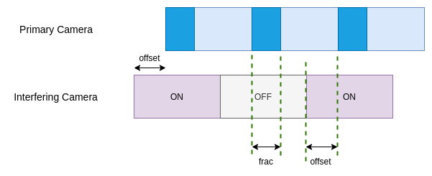
Relationship between Frac and Interference – Case 2
1 If offset < 0 (right case):
2 slot[N] = ! intSlot[N]
3 if offset < 1 - frac:
4 slot[N] = ! intSlot[N+1]
5 else:
6 intAmt[N] = abs(offset)
slot[.] is an array with values 0/1 depicting whether nth slot of primary camera is ON or OFF.
intAmt[.] holds the total observed interference for nth slot for the primary camera.

Slide 19
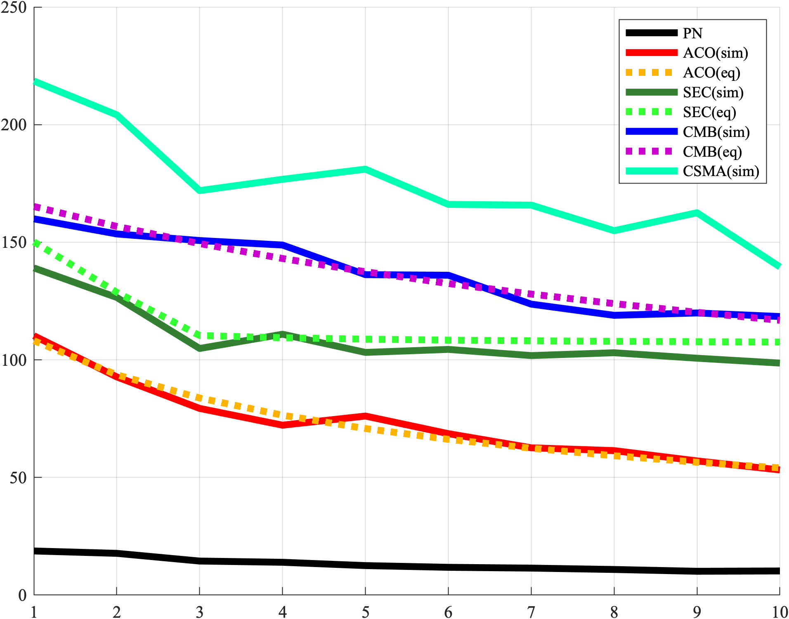
Results: Simulation
Comparison Baselines:
PN (Pseudonoise): Uses non-sinusoid modulation and demodulation functions.
ACO (AC Orthogonal): Using orthogonal frequencies for the interfering cameras.
SEC (Stochastic Exposure Coding): Makes use of a stochastic TDMA protocol
CMB: Combined ACO and SEC
CSMA: Intervention to use a-priori carrier sensing
Following results are for CSMA approach using the frac = 0.1, half Power Amplification as SEC, 10% increase in probability p_CMB
Inverse Standard Deviation
Interfering Cameras

Slide 20
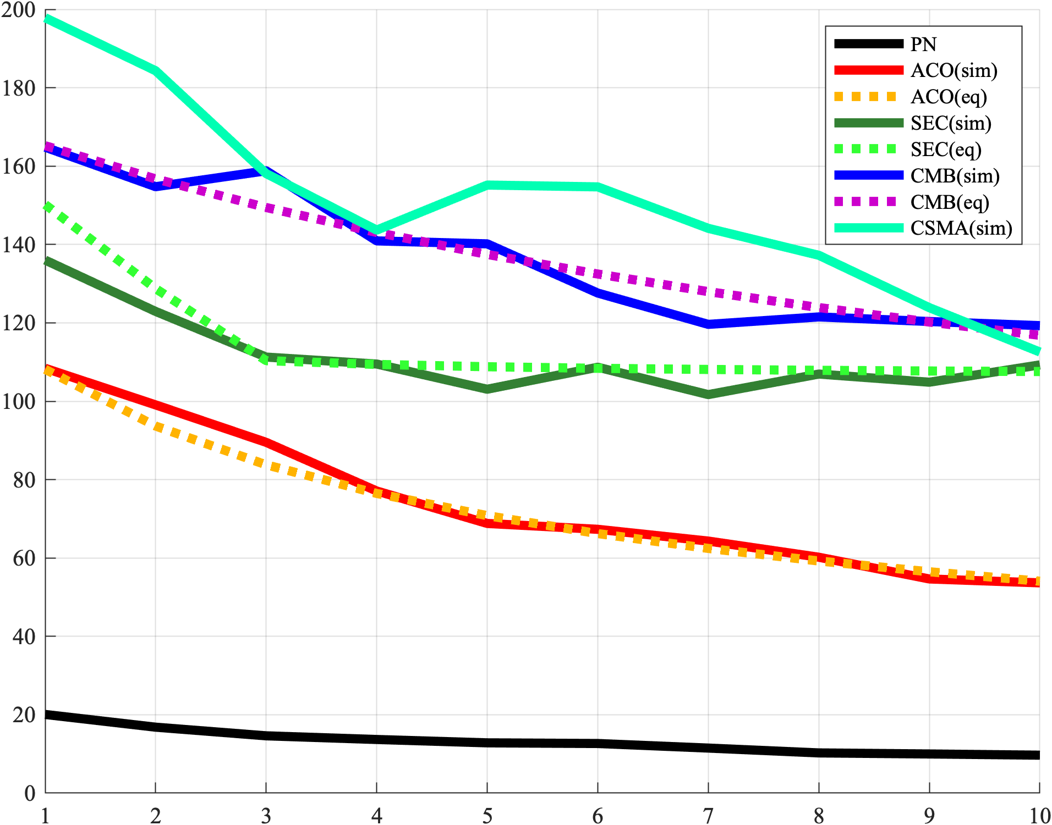
Results: Simulation
Comparison Baselines:
PN (Pseudonoise): Uses non-sinusoid modulation and demodulation functions.
ACO (AC Orthogonal): Using orthogonal frequencies for the interfering cameras.
SEC (Stochastic Exposure Coding): Makes use of a stochastic TDMA protocol
CMB: Combined ACO and SEC
CSMA: Intervention to use a-priori carrier sensing
Following results are for CSMA approach using the frac = 0.3, half Power Amplification as SEC, 10% increase in probability p_CMB
Inverse Standard Deviation
Interfering Cameras

Slide 21
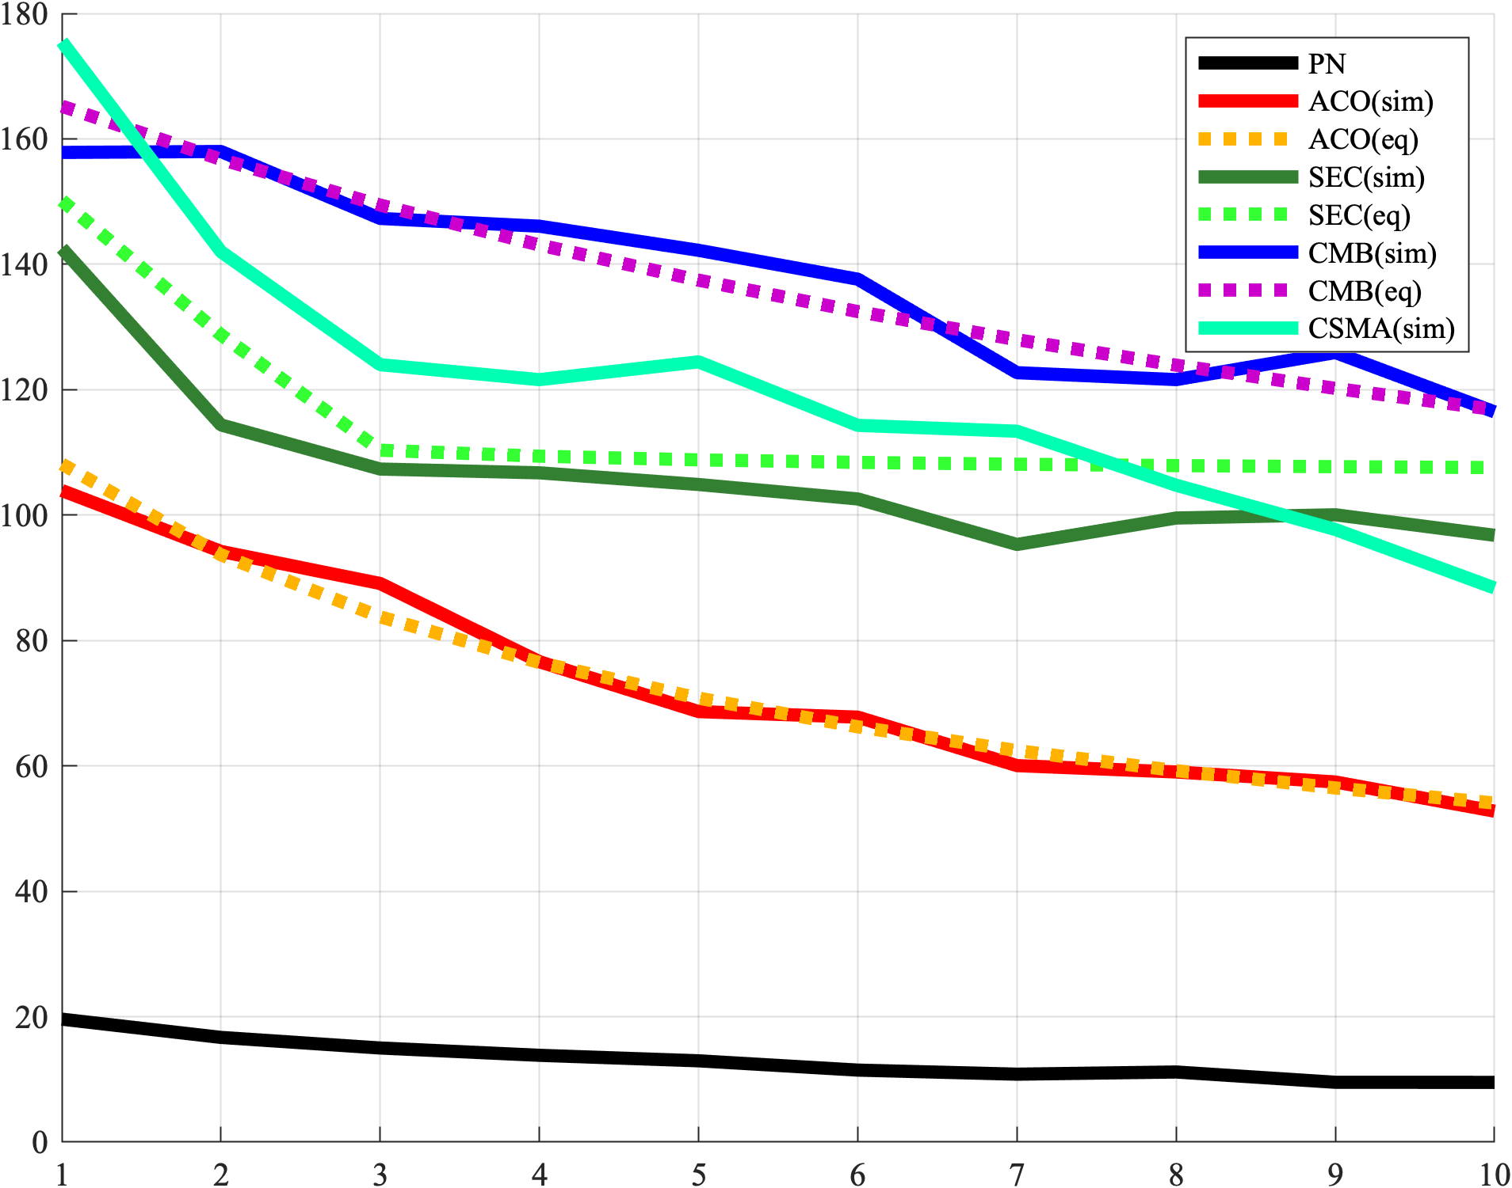
Results: Simulation
Comparison Baselines:
PN (Pseudonoise): Uses non-sinusoid modulation and demodulation functions.
ACO (AC Orthogonal): Using orthogonal frequencies for the interfering cameras.
SEC (Stochastic Exposure Coding): Makes use of a stochastic TDMA protocol
CMB: Combined ACO and SEC
CSMA: Intervention to use a-priori carrier sensing
Following results are for CSMA approach using the frac = 0.5, half Power Amplification as SEC, 10% increase in probability p_CMB
Inverse Standard Deviation
Interfering Cameras

Slide 22
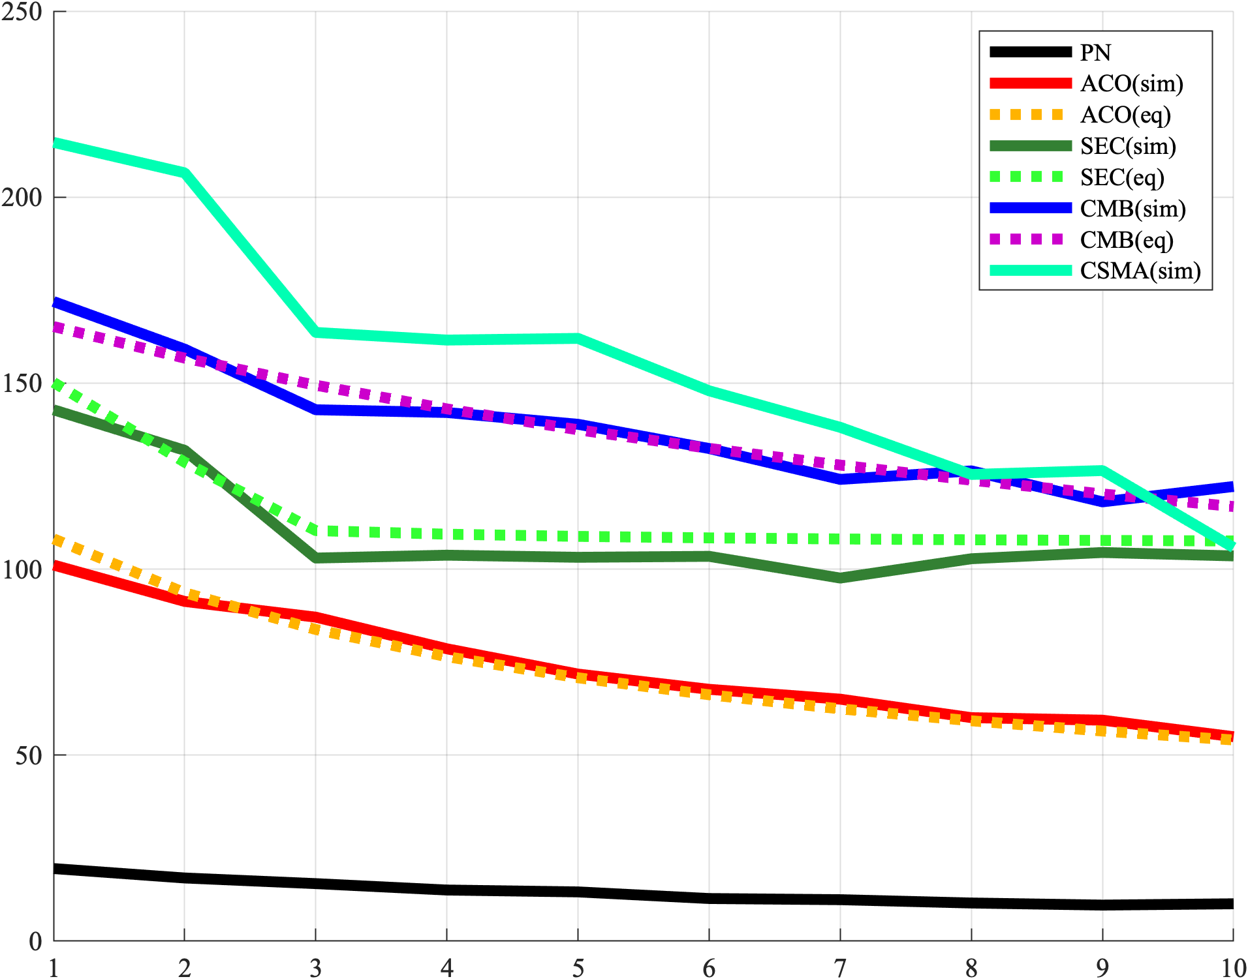
Results: Simulation
Comparison Baselines:
PN (Pseudonoise): Uses non-sinusoid modulation and demodulation functions.
ACO (AC Orthogonal): Using orthogonal frequencies for the interfering cameras.
SEC (Stochastic Exposure Coding): Makes use of a stochastic TDMA protocol
CMB: Combined ACO and SEC
CSMA: Intervention to use a-priori carrier sensing
Following results are for CSMA approach using the frac = 0.5, 75% Power Amplification as SEC, 10% increase in probability p_CMB
Inverse Standard Deviation
Interfering Cameras

Slide 23
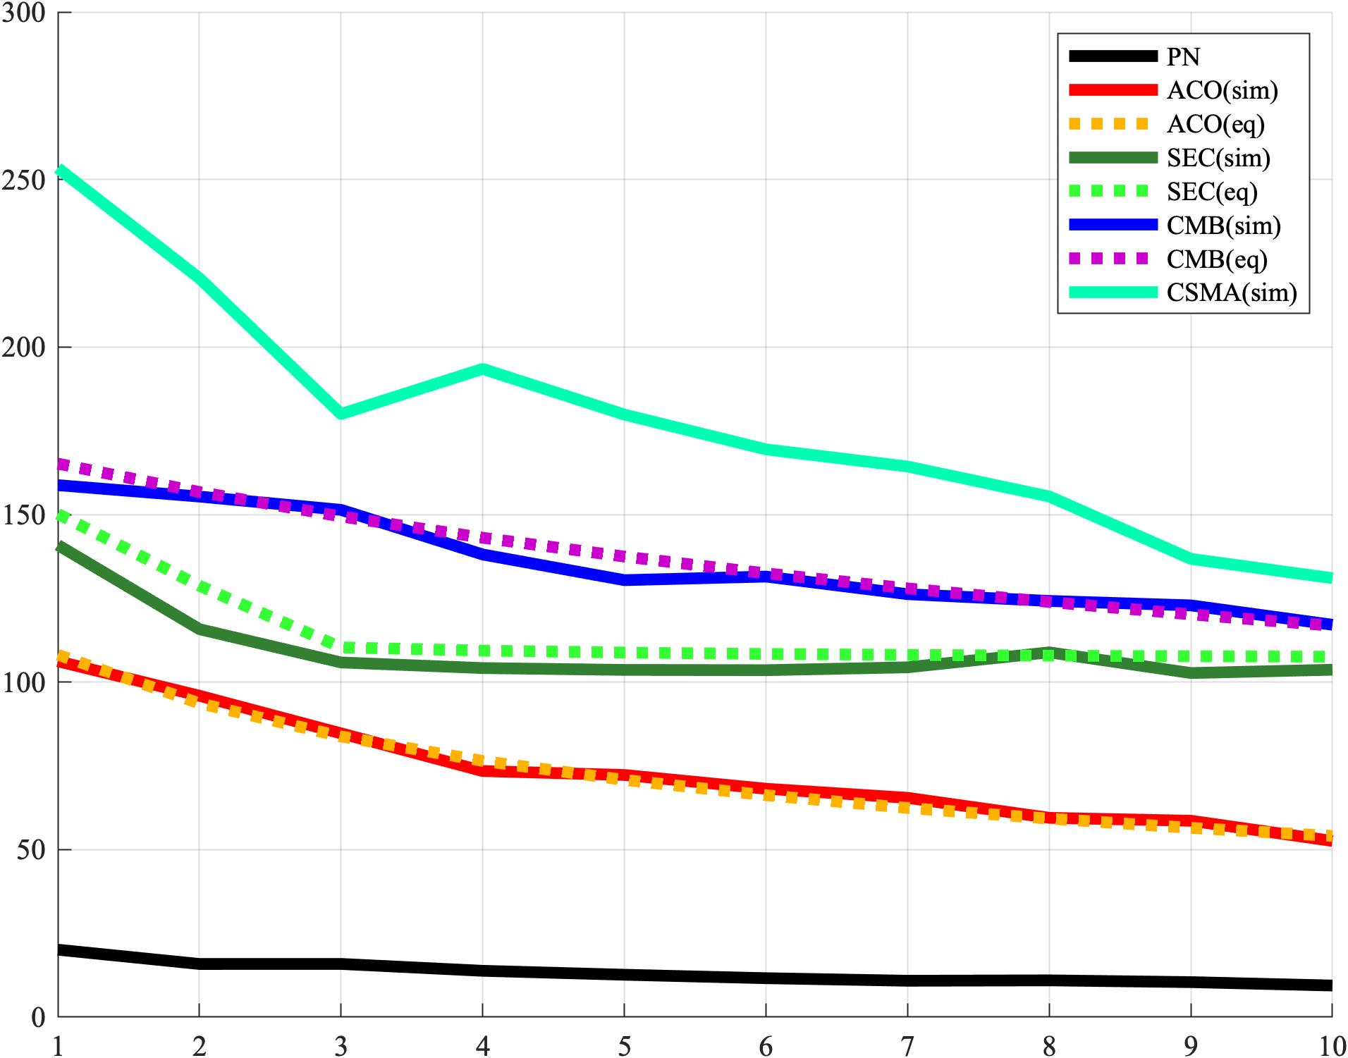
Results: Simulation
Comparison Baselines:
PN (Pseudonoise): Uses non-sinusoid modulation and demodulation functions.
ACO (AC Orthogonal): Using orthogonal frequencies for the interfering cameras.
SEC (Stochastic Exposure Coding): Makes use of a stochastic TDMA protocol
CMB: Combined ACO and SEC
CSMA: Intervention to use a-priori carrier sensing
Following results are for CSMA approach using the frac = 0.5, same Amplification as SEC, 10% increase in probability p_CMB
Inverse Standard Deviation
Interfering Cameras

Slide 24
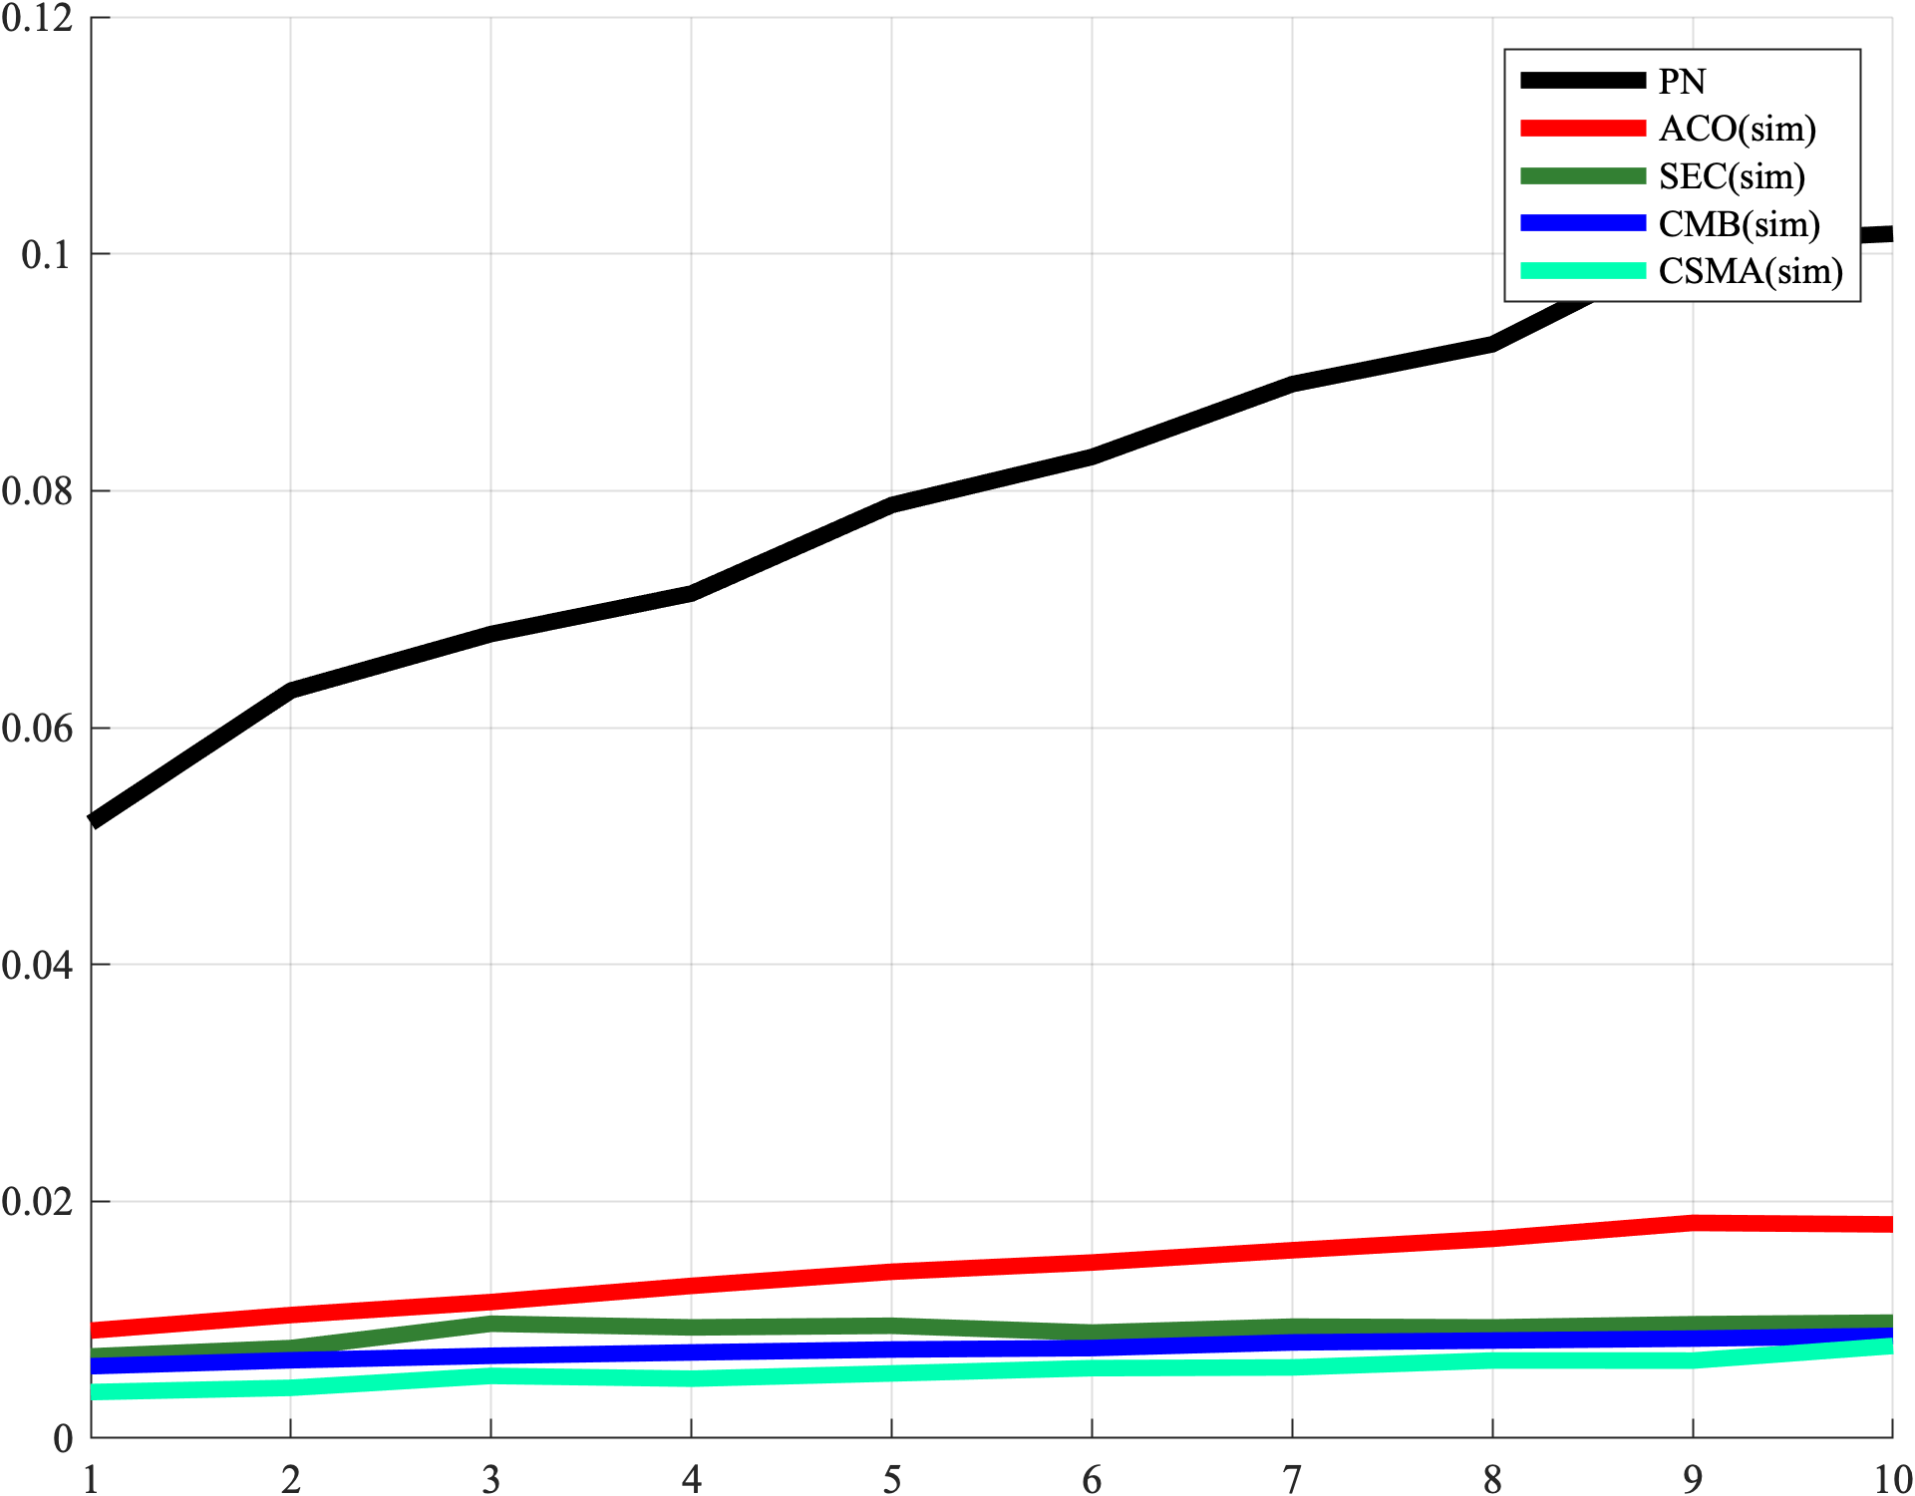
Results: Simulation
Comparison Baselines:
PN (Pseudonoise): Uses non-sinusoid modulation and demodulation functions.
ACO (AC Orthogonal): Using orthogonal frequencies for the interfering cameras.
SEC (Stochastic Exposure Coding): Makes use of a stochastic TDMA protocol
CMB: Combined ACO and SEC
CSMA: Intervention to use a-priori carrier sensing
Following results are for CSMA approach using the frac = 0.5, same Amplification as SEC, 10% increase in probability p_CMB
Root Mean Square Error
Interfering Cameras

Slide 25
Conclusion
CSMA approach does give a better performance over SEC under the same experimental setting.
There is a direct correlation between time spent in collision detection and the accuracy of estimated depth.
Reduction in depth estimation time can be compensated by increasing the power amplification.

Slide 26
Next Steps
Include power amplification needed for carrier sensing in the total power calculation.
Theoretical bounds for the peak power amplification for the carrier sensing protocol.
Simulate a real world setting where each interfering camera can follow a different protocol.

Slide 27
Thank you !
Questions ?

